Slide 1
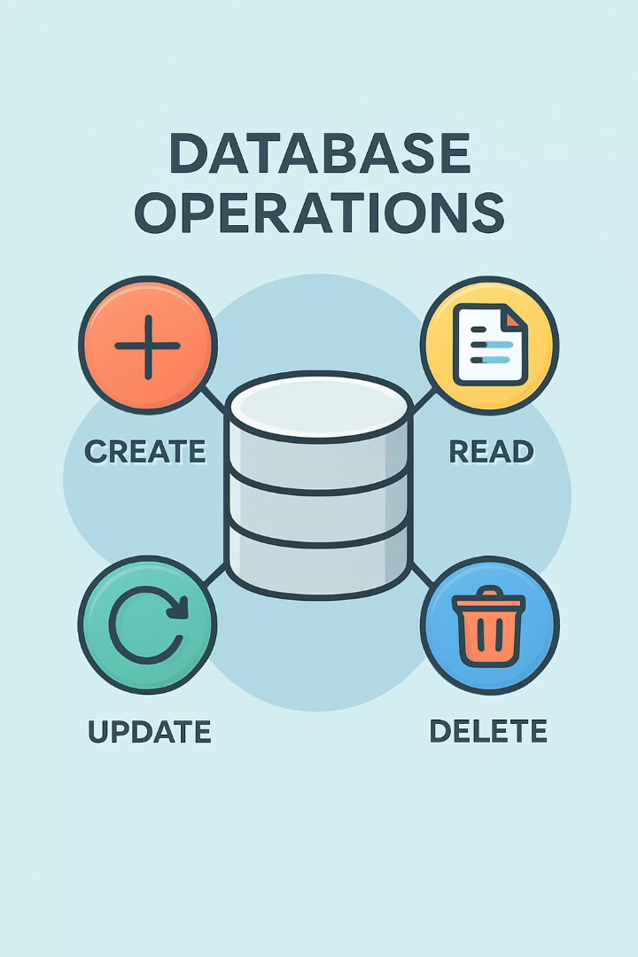
CRUD Operations in Mobile Apps with SQLite
Welcome to this comprehensive guide on CRUD operations - Create, Read, Update, and Delete - and how they are used to manage data in mobile applications with SQLite. These fundamental database operations form the backbone of data management in app development.
Throughout this presentation, we'll explore how SQLite, a lightweight serverless database engine, enables efficient data handling in mobile environments. You'll learn practical applications through real-world examples and discover how to implement these operations in your own projects.

Slide 2


Learning Objectives
1
Understand CRUD Fundamentals
Describe the purpose and importance of Create, Read, Update, and Delete operations in database management
2
Master SQLite Implementation
Demonstrate how to perform CRUD operations using SQLite in mobile applications
3
Explore Practical Applications
Discuss real-world uses of SQLite in mobile development and its advantages
4
Build a Contact Management App
Apply CRUD operations to create a functional contact management mobile application

Slide 3
The Need for Efficient Data Management
The Challenge
The Solution
Building mobile apps that manage user data like contacts or tasks requires efficient storage and retrieval systems. Without robust operations, applications face significant performance issues and data inconsistencies.
CRUD operations provide a structured approach to data management, allowing developers to build apps that handle information smoothly and efficiently. SQLite offers the perfect lightweight database solution for mobile environments.

Slide 4

Introduction to SQLite
Lightweight
SQLite is a compact database engine that requires minimal resources, making it ideal for mobile applications with limited processing power and storage.
Serverless
Unlike traditional database systems, SQLite doesn't require a separate server process, allowing it to function entirely within the application.
Self-Contained
The entire database is stored in a single cross-platform file, simplifying data management and portability across different devices.
Minimal Configuration
SQLite requires very little setup, making it accessible for developers of all skill levels and reducing development time.

Slide 5








Understanding CRUD Operations
Create
Read
Add new records to the database using INSERT statements
Retrieve data from the database using SELECT statements
Delete
Update
Remove unwanted records using DELETE statements
Modify existing records using UPDATE statements

Slide 6




The Library App Example
Let's explore CRUD operations through a practical example of a library mobile application. This scenario demonstrates how each operation functions in a real-world context.
Library Management
Data Storage
Mobile Access
Using SQLite to maintain records of books, including titles, authors, and publication years
Allowing librarians to update the database on-the-go from tablets or smartphones
A mobile application that helps librarians track books, manage inventory, and assist patrons

Slide 7



Create Operation: Adding New Books
Identify New Book
Librarian receives "The Great Gatsby" by F. Scott Fitzgerald
Prepare INSERT Statement
Construct SQL command with book details
Execute Command
Add record to the database
The INSERT statement adds a new book to the 'books' table with title "The Great Gatsby", author "F. Scott Fitzgerald", and publication year 1935 (which we'll later correct using the Update operation).

Slide 8
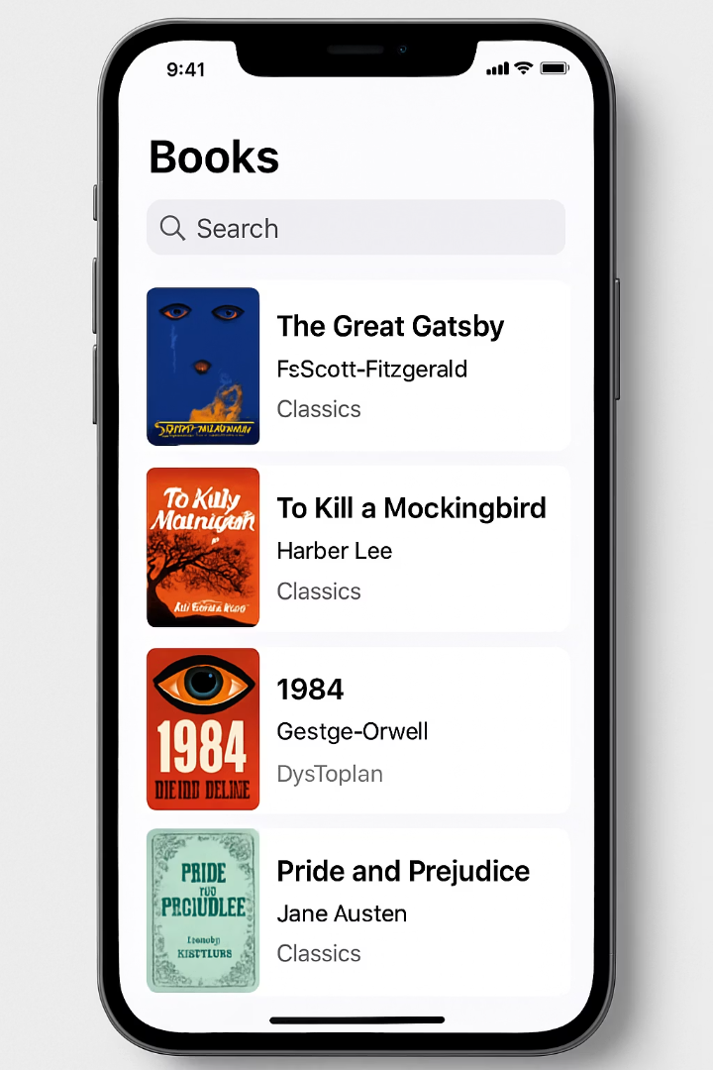
Read Operation: Retrieving Book Information
Operation
SELECT
Purpose
Retrieve data from database
Example
SELECT * FROM books
Result
Displays all books in library
Variation
Can filter with WHERE clause
The Read operation allows librarians to view the current inventory, check availability, and access book details. This information can be displayed in the app's interface for easy browsing and searching.

Slide 9





Update Operation: Correcting Book Details
Identify Error
Notice incorrect publication year
Prepare UPDATE Statement
Construct SQL with correct information
Execute Update
Modify the database record
Verify Change
Confirm year now shows as 1925
The UPDATE statement finds the record where the title is "The Great Gatsby" and corrects the publication year from 1935 to 1925, ensuring the database maintains accurate information.

Slide 10






Delete Operation: Removing Books
Remove Record
Book completely deleted from database
DELETE Statement
DELETE FROM books WHERE title = 'The Great Gatsby'
Book No Longer Available
When a book leaves the collection permanently
The Delete operation allows librarians to maintain an accurate inventory by removing books that are no longer part of the collection. This ensures patrons only see available items and helps manage library space effectively.

Slide 11
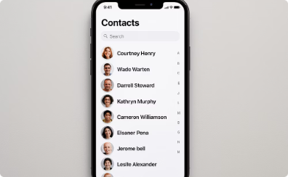
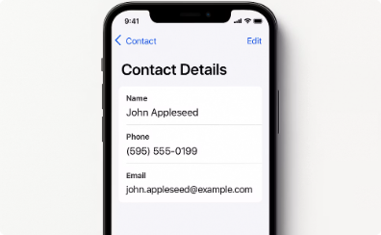
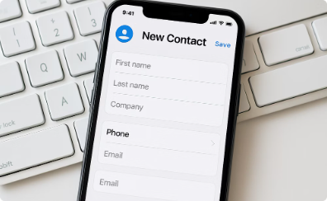
Contact Management Application
Now let's explore a practical example of implementing CRUD operations in a contact management mobile application using SQLite. This example demonstrates how these operations work together in a common app scenario.
Contact List View
The main screen displays all contacts retrieved from the SQLite database using the Read operation
Contact Details
Individual contact information is displayed when selected, with options to edit or delete
Add New Contact
Interface for creating new contacts that will be added to the database using the Create operation

Slide 12
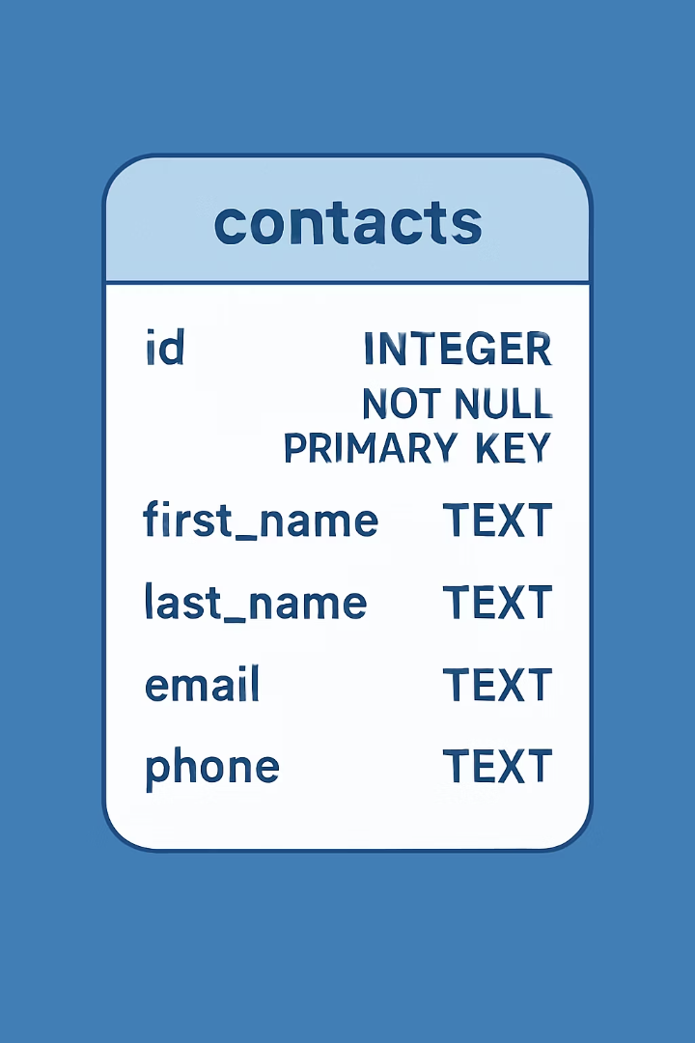
Creating the Contacts Database
CREATE TABLE contacts ( id INTEGER PRIMARY KEY, name TEXT NOT NULL, phone TEXT NOT NULL, email TEXT );
The first step in building our contact management app is creating the SQLite database structure. We define a table called 'contacts' with four fields: a unique identifier (id), the contact's name, phone number, and email address.
The PRIMARY KEY constraint ensures each contact has a unique identifier, while NOT NULL constraints on name and phone fields ensure these essential details are always provided. The email field is optional, so it doesn't have this constraint.

Slide 13
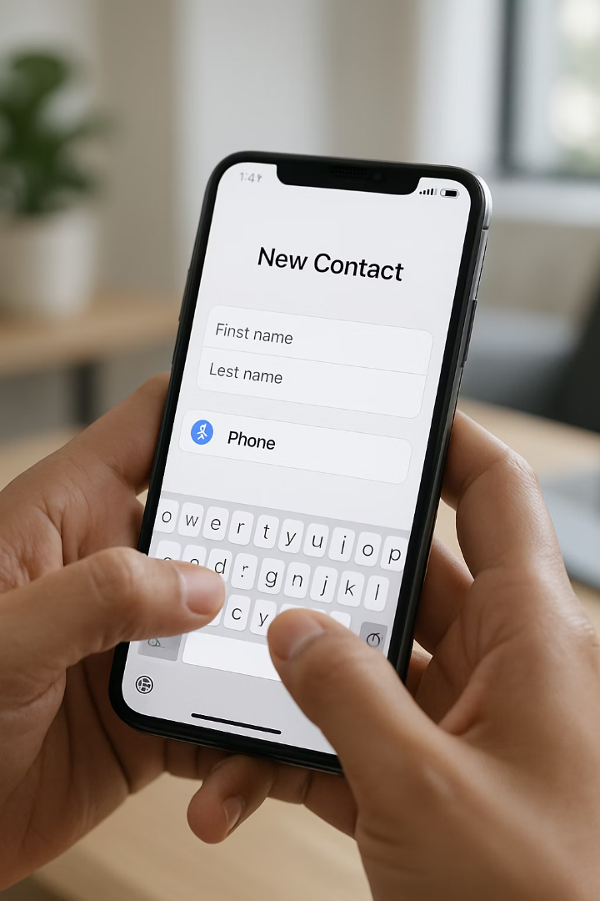
Create: Adding a New Contact
1
2
Collect Information
Prepare SQL
User inputs contact details through the app interface
App constructs INSERT statement with provided information
3
Execute Command
New record added to contacts table in SQLite database
The INSERT statement adds "John Doe" to the contacts table with phone number "1234567890" and email "john@example.com". The database automatically assigns a unique ID to this new contact.

Slide 14
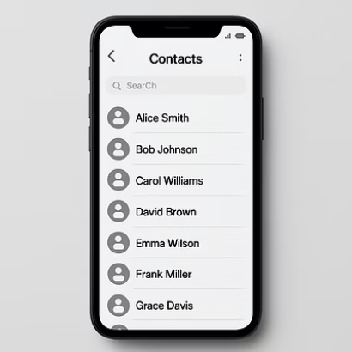
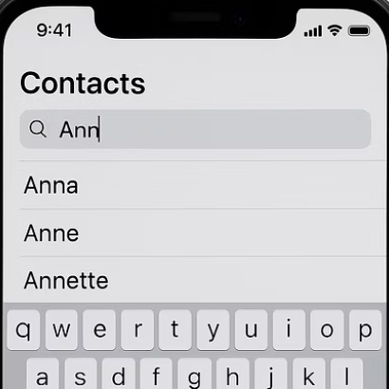
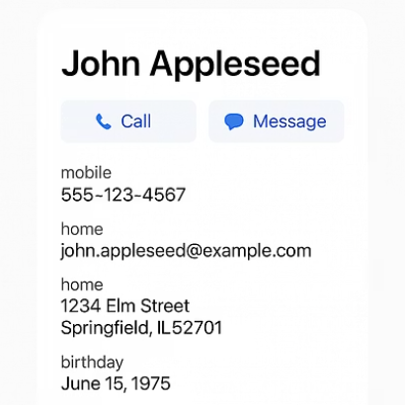
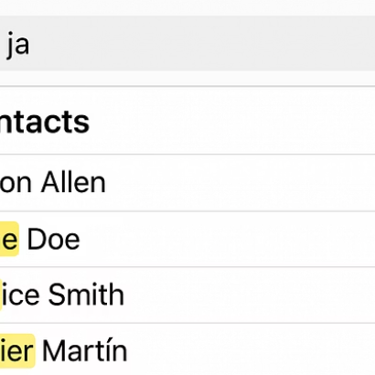
Read: Viewing Contact Information
The Read operation allows users to view all contacts or search for specific ones. The SELECT statement retrieves records from the contacts table, which can be filtered using a WHERE clause to find specific contacts like "John Doe".
This operation powers the main contact list view and the detailed contact information screens, providing users with access to their stored contact data.

Slide 15
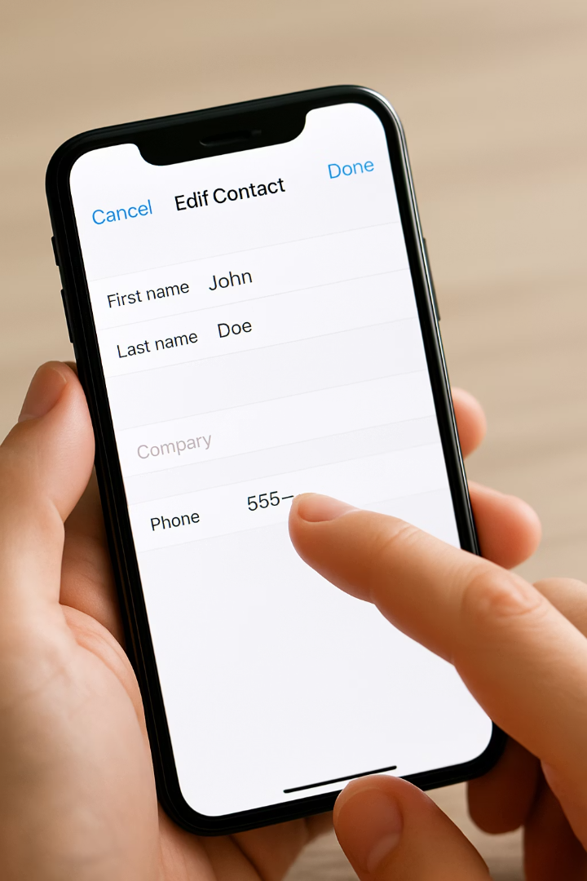
Update: Modifying Contact Details
Select Contact
User chooses which contact to modify from the list
Edit Information
User updates the phone number to "9876543210"
Save Changes
App executes UPDATE statement to modify the database record
The UPDATE statement modifies John Doe's phone number in the database. The SET clause specifies which field to change (phone), and the WHERE clause ensures only John's record is updated. This allows users to keep their contact information current as details change.

Slide 16








Delete: Removing a Contact
Select Contact
Delete Action
User identifies contact to remove
User initiates deletion process
Execute DELETE
Confirm Deletion
Record removed from database
App requests confirmation
The DELETE FROM statement removes John Doe's record from the contacts table. The WHERE clause ensures only the specific contact is deleted. This operation allows users to keep their contact list current by removing outdated or unwanted entries.

Slide 17

Task Management App Example
Create Tasks
Users add new tasks with details like title, description, due date, and priority
View Tasks
App displays task lists, filtered by status, priority, or due date
Modify Tasks
Users update task details or mark tasks as in-progress or complete
Remove Tasks
Completed or unnecessary tasks can be deleted from the system

Slide 18

Offline Capabilities with SQLite
Local Storage
Sync When Available
SQLite databases are stored directly on the device, allowing full functionality without an internet connection. Users can continue to create, read, update, and delete data regardless of connectivity status.
Changes made offline can be synchronized with cloud services when connectivity is restored. This ensures data consistency across devices without requiring constant internet access.
Improved User Experience
Users experience no interruption in service when entering areas with poor reception or during temporary network outages. The app continues to function normally, maintaining a seamless experience.

Slide 19






Memory Efficiency in Mobile Apps
Optimized Performance
Smooth user experience with minimal lag
Selective Loading
Only retrieve needed data with WHERE clauses
Lightweight Database
SQLite's minimal footprint preserves resources
Mobile devices have limited resources, making efficient memory management crucial. SQLite's lightweight nature combined with well-implemented CRUD operations allows developers to minimize resource usage while maintaining functionality.
By loading only the data needed for current operations and releasing resources when finished, apps can run smoothly even on devices with limited RAM and processing power.

Slide 20





Performance Optimization Techniques
Use Indexes Wisely
Create indexes on columns frequently used in WHERE clauses to speed up search operations. However, avoid over-indexing as it can slow down INSERT and UPDATE operations.
Implement Transactions
Wrap multiple related CRUD operations in transactions to ensure data integrity and improve performance when making several changes at once.
Optimize Queries
Select only the columns you need rather than using SELECT * and limit result sets to necessary records to reduce memory usage and processing time.
Batch Operations
Combine multiple operations when possible, such as inserting multiple records in a single transaction, to reduce overhead and improve speed.

Slide 21
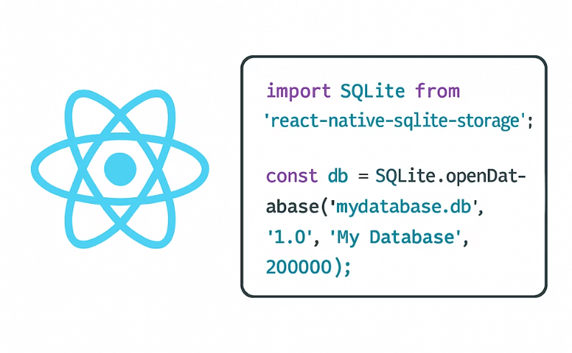
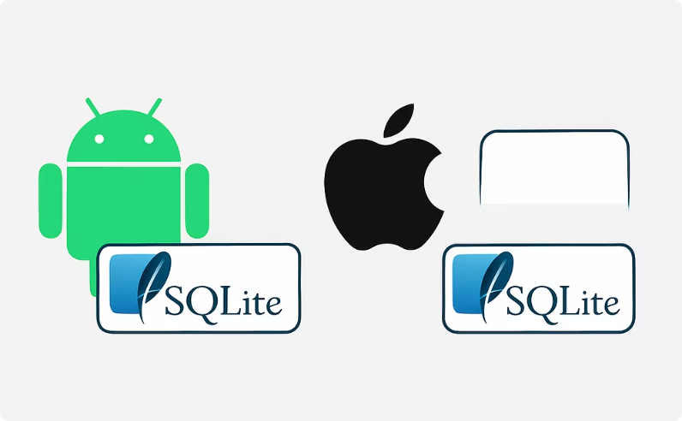
Integrating with Mobile UI Frameworks
React Native
Native Development
Use react-native-sqlite-storage package to implement CRUD operations in cross-platform React Native applications, with a JavaScript interface to the native SQLite databases.
Use Room persistence library for Android or Core Data with SQLite store for iOS to implement type-safe CRUD operations with native performance benefits.

Slide 22
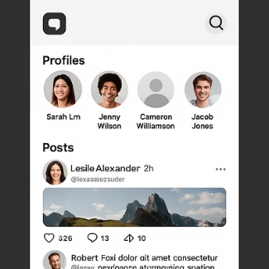
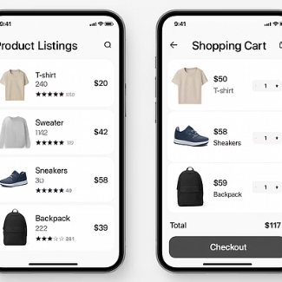
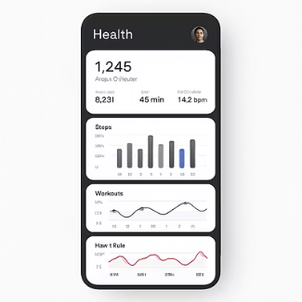
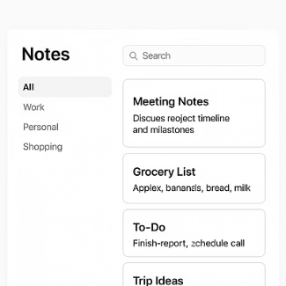
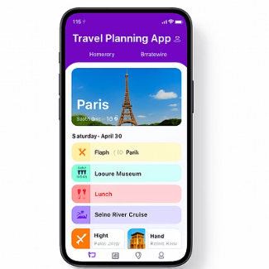
Real-World Applications
CRUD operations with SQLite power countless popular mobile applications across various categories. Social media apps use these operations to manage user posts and interactions. E-commerce apps maintain product catalogs and shopping carts. Health trackers store fitness data and progress metrics.
Note-taking apps save and organize user content, while travel apps manage itineraries and bookings. The versatility of CRUD operations makes them essential for virtually any app that needs to maintain persistent data.

Slide 23
Next Lab Activity: Enhance SQLite Database in a React Native App
In this hands-on lab, you'll implement efficient CRUD operations using the react-native-sqlite-storage package we discussed. You'll apply performance optimization techniques like indexing, transactions, and query optimization while building a functional contact management application.
Estimated completion time: 30 minutes. Be sure to have your React Native development environment ready before starting.

Slide 24





Key Takeaways
CRUD Essentials
Create, Read, Update, Delete operations form the foundation of data management in mobile apps
SQLite Benefits
Lightweight, serverless database perfect for mobile environments with limited resources
Implementation
Use INSERT, SELECT, UPDATE, and DELETE statements to manage app data efficiently
Practical Value
Enable offline capabilities, data synchronization, and efficient memory usage in mobile apps

